Slide 1
Formal Methods Lecture # 1
Umber Noureen Abbas
Lecturer
Department of Computer Science

Slide 2
Formal Method
Introduction

Slide 3
Learning Objective
What are formal methods in software development? SDLC
Waterfall SDLC

Slide 4
What are formal methods in software development?
In software development, formal methods are mathematical approaches to solving software (and hardware) problems at the requirements, specification, and design levels. Formal methods are most likely to be applied to safety-critical or security-critical software and systems, such as avionics software.

Slide 5
SDLC
Stage 1. Planning and requirement analysis
Stage 2. Designing project architecture
Stage 3. Development and programming
Stage 4. Testing
Stage 5. Deployment

Slide 6
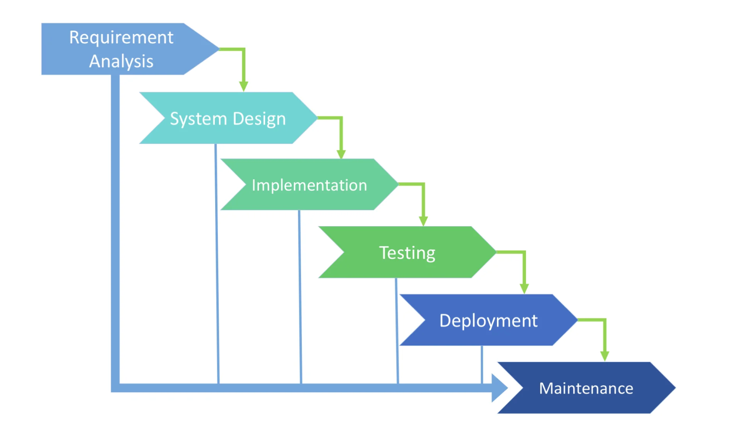
Waterfall SDLC

Slide 7
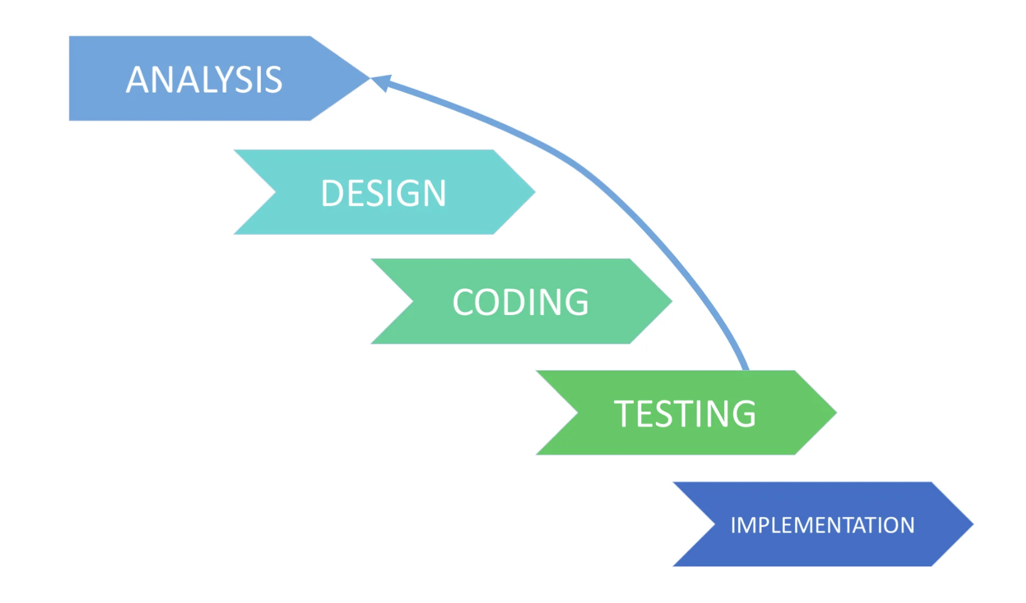
Iterative Model

Slide 8
COSMIC TRUTH 1
If you don’t get the
requirements right, it
doesn‘t matter how
well you execute the
rest of the project

Slide 9
COSMIC TRUTH 2
Customer
involvement is
the most critical
factor in achieving
software quality.

Slide 10

Obtaining Customer Involvement
Identify user classes
Select “product champions”
Employ the use case technique
Understand how product will be used
Scenarios
operational profile
Build prototypes
Agree on customer rights and responsibilities

Slide 11
COSMIC TRUTH 5
The customer is
not always right.
But the customer
always has a point.

Slide 12
How can customer not be right?
Presenting solutions in the guise of requirements
Not prioritizing requirements
Not communicating or respecting business rules or constraints
Not making decisions
Not accepting the need for tradeoffs
Demanding impossible commitments
Not accepting the cost of change

Slide 13
COSMIC TRUTH 6
The first question an
analyst should ask
about a proposed
new requirement is,
“Is this in scope?”

Slide 14
Questions
Any Question Please?
You can contact me at: umber@uosahiwal.edu.pk
Your Query will be answered within one working day.

Slide 15
Thanks

